Slide 1
Urinary incontinence in women Epidemiology
Dr. Parvin Bastani
Gynecologist
Urogynecology Fellowship
Associated Professor
Tabriz University of Medical Sciences

Slide 2
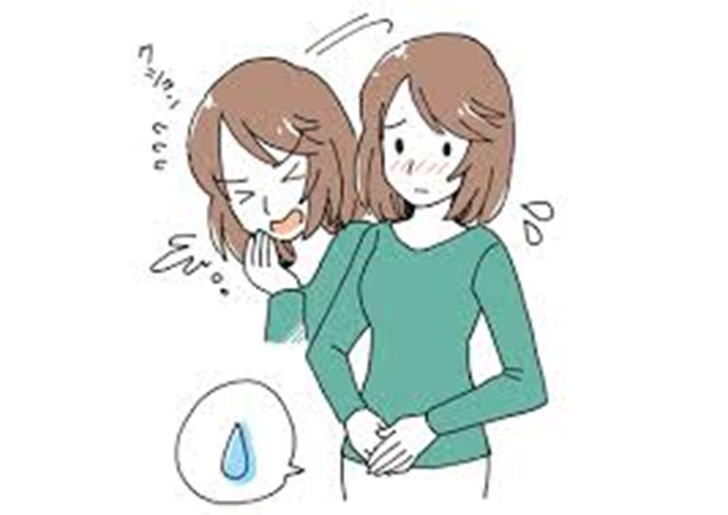
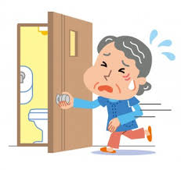
Definition
Urinary incontinence:
Involuntary loss of urine

Slide 3
Main Types of Incontinence
Stress incontinence: Loss of urine with exertion or sneezing or coughing.
Urgency incontinence: Leakage accompanied by or immediately preceded by urinary urgency.
Mixed incontinence: Loss of urine associated with urgency and also with exertion, effort, sneezing, or coughing.
Overflow incontinence: Leakage of urine associated with urinary retention.
Continuous incontinence: Is the complaint of a continuous leakage.

Slide 4
What is Needed for Normal Bladder Function?
Filling - Efficient and low pressure
Storage - Low pressure, with perfect continence
Emptying - Periodic complete urine expulsion, at low pressure, when convenient
Bladder innervation
Sympathetic (Hypogastric nerve)
Parasympathetic (Pelvic Nerve)
Somatic (Pudendal Nerve)

Slide 5
Storage Phase

Slide 6
Voiding Phase

Slide 7
Lower Urinary Symptoms

Slide 8
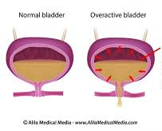
Terminology
OVERACTIVE BLADDER (ABRAMS ET AL. 2002)
The International Continence Society (ICS) defined overactive bladder (OAB) syndrome as “urinary urgency, usually accompanied by frequency and nocturia, with or without urgency urinary incontinence (UUI), in the absence of urinary tract infection (UTI) or other obvious pathology”
Wet: urgency ,frequency with incontinence
OAB
Dry: urgency ,frequency without incontinence
URGENCY (HAYLEN ET AL. 2010)
Sudden, compelling desire to void which is difficult to defer.

Slide 11
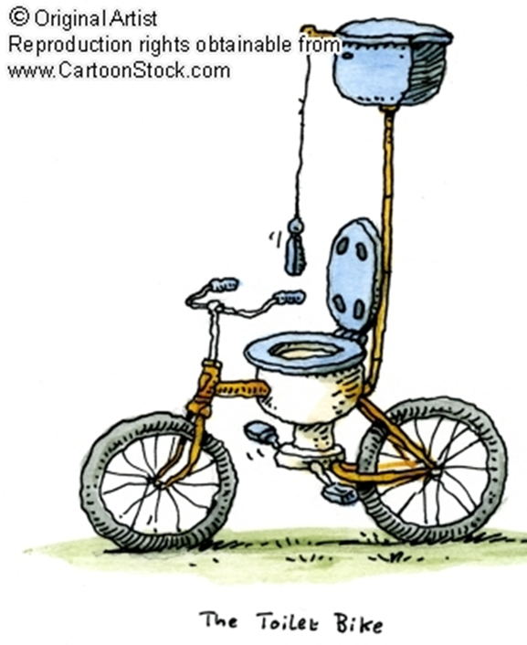
Urge incontinence Urgency Incontinence
The syndrome of OAB is based on symptoms; in contrast, detrusor overactivity (DO) is a urodynamic observation, characterized by involuntary detrusor contractions during the filling phase, which may be spontaneous or provoked.
Mixed urinary incontinence (MUI) is the “complaint of involuntary loss of urine associated with urgency and also with effort or physical exertion or on sneezing or coughing” (Haylen et al., 2010).

Slide 12
Distinguishing Overactive Bladder From Bladder Pain Syndrome

Slide 13
Urge vs Pain

Slide 14
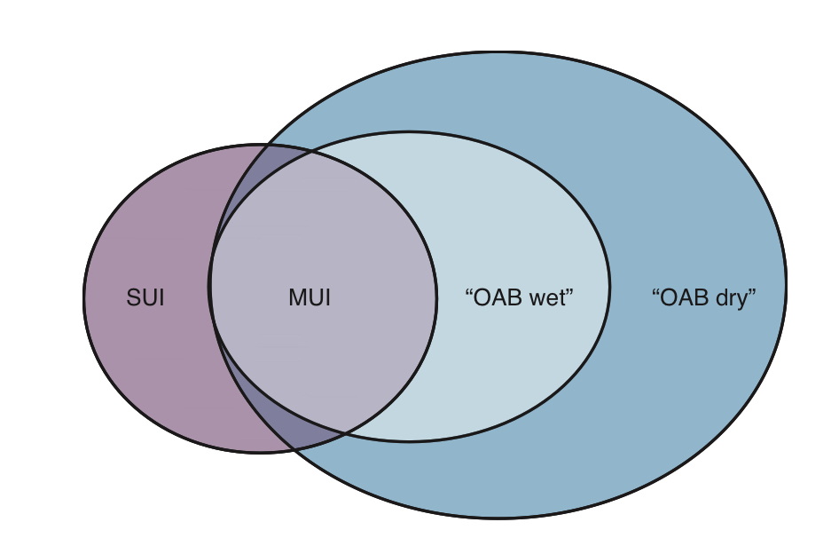

Slide 15
Epidemiology
OAB is common in men and women but tends to disparately affect women.
Most epidemiologic studies report a prevalence of OAB in women of approximately 1.5 to 2 times that of men and rates of UUI of 2 to 3 times those in men.
Although in the National Overactive Bladder Evaluation Study
(NOBLE), the incidence of OAB was similar at 16.9% in women and 16.0% in men
7.6% of women reported UUI versus just 2.6% of men
The prevalence of symptoms of OAB increases with aging , appearing to increase in women in their 40s and men in their 50s and 60s.

Slide 17
Economics
in the United States, including direct costs (i.e., medical and nonmedical) and indirect costs (i.e., lost productivity), approached $65.9 billion in 2007, with projected increases to $76.2 billion and $82.6 billion in 2015 and 2020.

Slide 18
A total of 485 (29.8%) women reported urinary incontinence; 250 (69.9%) urinary incontinent women experienced symptoms less than once a month.
Regarding knowledge, attitudes, and practices, 822 (54.3%) of the women surveyed knew the meaning of urinary incontinence, and 147 (30.3%) with urinary incontinence had visited a doctor.
The main reason given for not seeking medical help was shyness

Slide 19
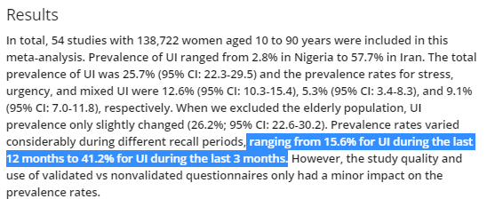

Slide 20
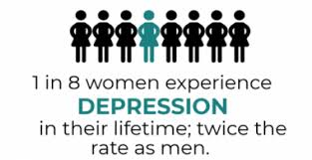
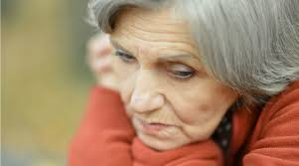
Negative Impacts of OAB
Social isolation
Depression
Embarrassment or shame of UI
Discontinue activities(physical, social, sexual…)
Skin irritation
disturbed sleep
decreased self-esteem
missed workdays
Falls and fractures
Reduce happiness
Negative effects on health-related quality of life (HRQoL)

Slide 21
Pathophysiology of OAB
Myogenic
Neurogenic
Urethrogenic
Ischemic
Obstruction
Mucosal

Slide 22
Transient Urinary Incontinence
D—delirium, dementia or both
I — infection
A— atrophic urethritis or vaginitis
P —pharmaceuticals or polypharmacy
P —psychological factors, especially depression
E— excessive urine output
R— restricted mobility
S— stool impaction
RULE OUT

Slide 24
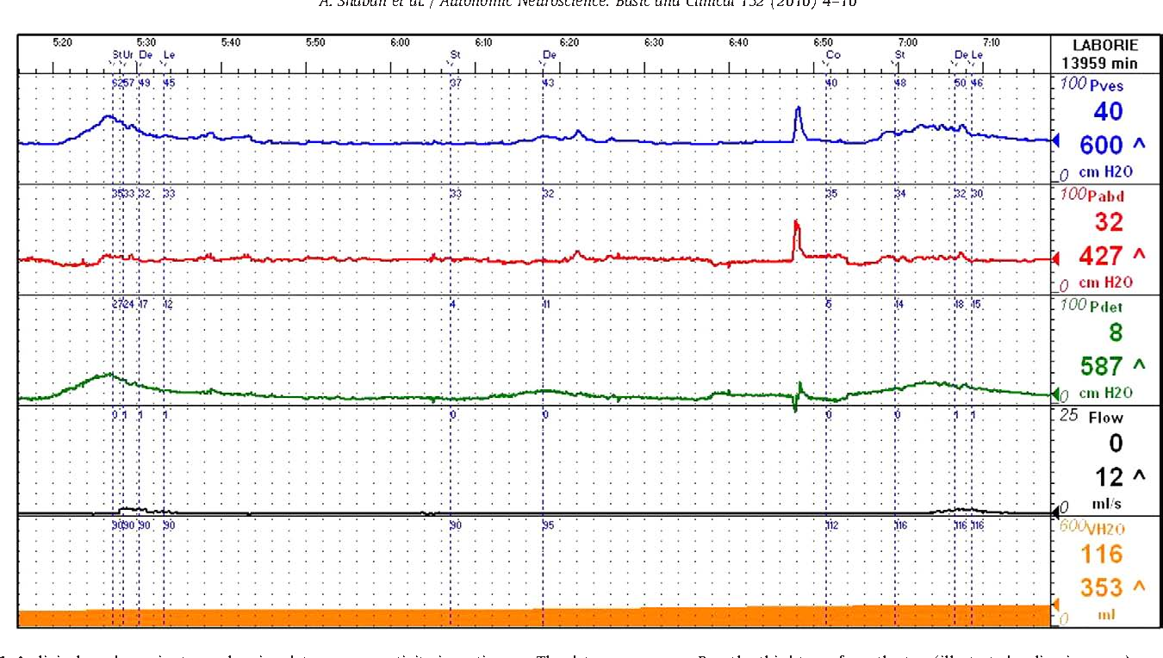
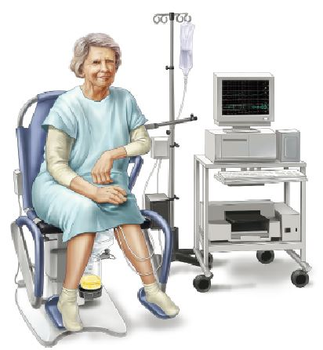
Urodynamic Study
Urodynamic testing is widely used as an adjunct to clinical diagnosis, in the belief that it may help to provide or confirm diagnosis, predict treatment outcome, or facilitate discussion during counselling.
For all these reasons, urodynamics is often performed prior to invasive treatment for UI.
The two main urodynamic diagnoses associated with OAB are DO and early and/or exaggerated filling sensation.
2020 EAU Guide line

Slide 25
Take-Home Massage
OAB is common condition in both men and women
Urgency urinary incontinence is the most common type of incontinence
History, Ph/E, urine analysis , PVR , bladder diary should be performed for all patient with OAB syndrome and incontinent .
Treatment should begin with conservative treatment (behavioral therapy , physiotherapy , pharmacotherapy)
Antimuscarins are used for overactive bladder
Surgical management should be used when other treatment will not bring positive results
Topical estrogen has positive effect in incontinence and surgical outcomes

Slide 26
Thank you

